Slide 1
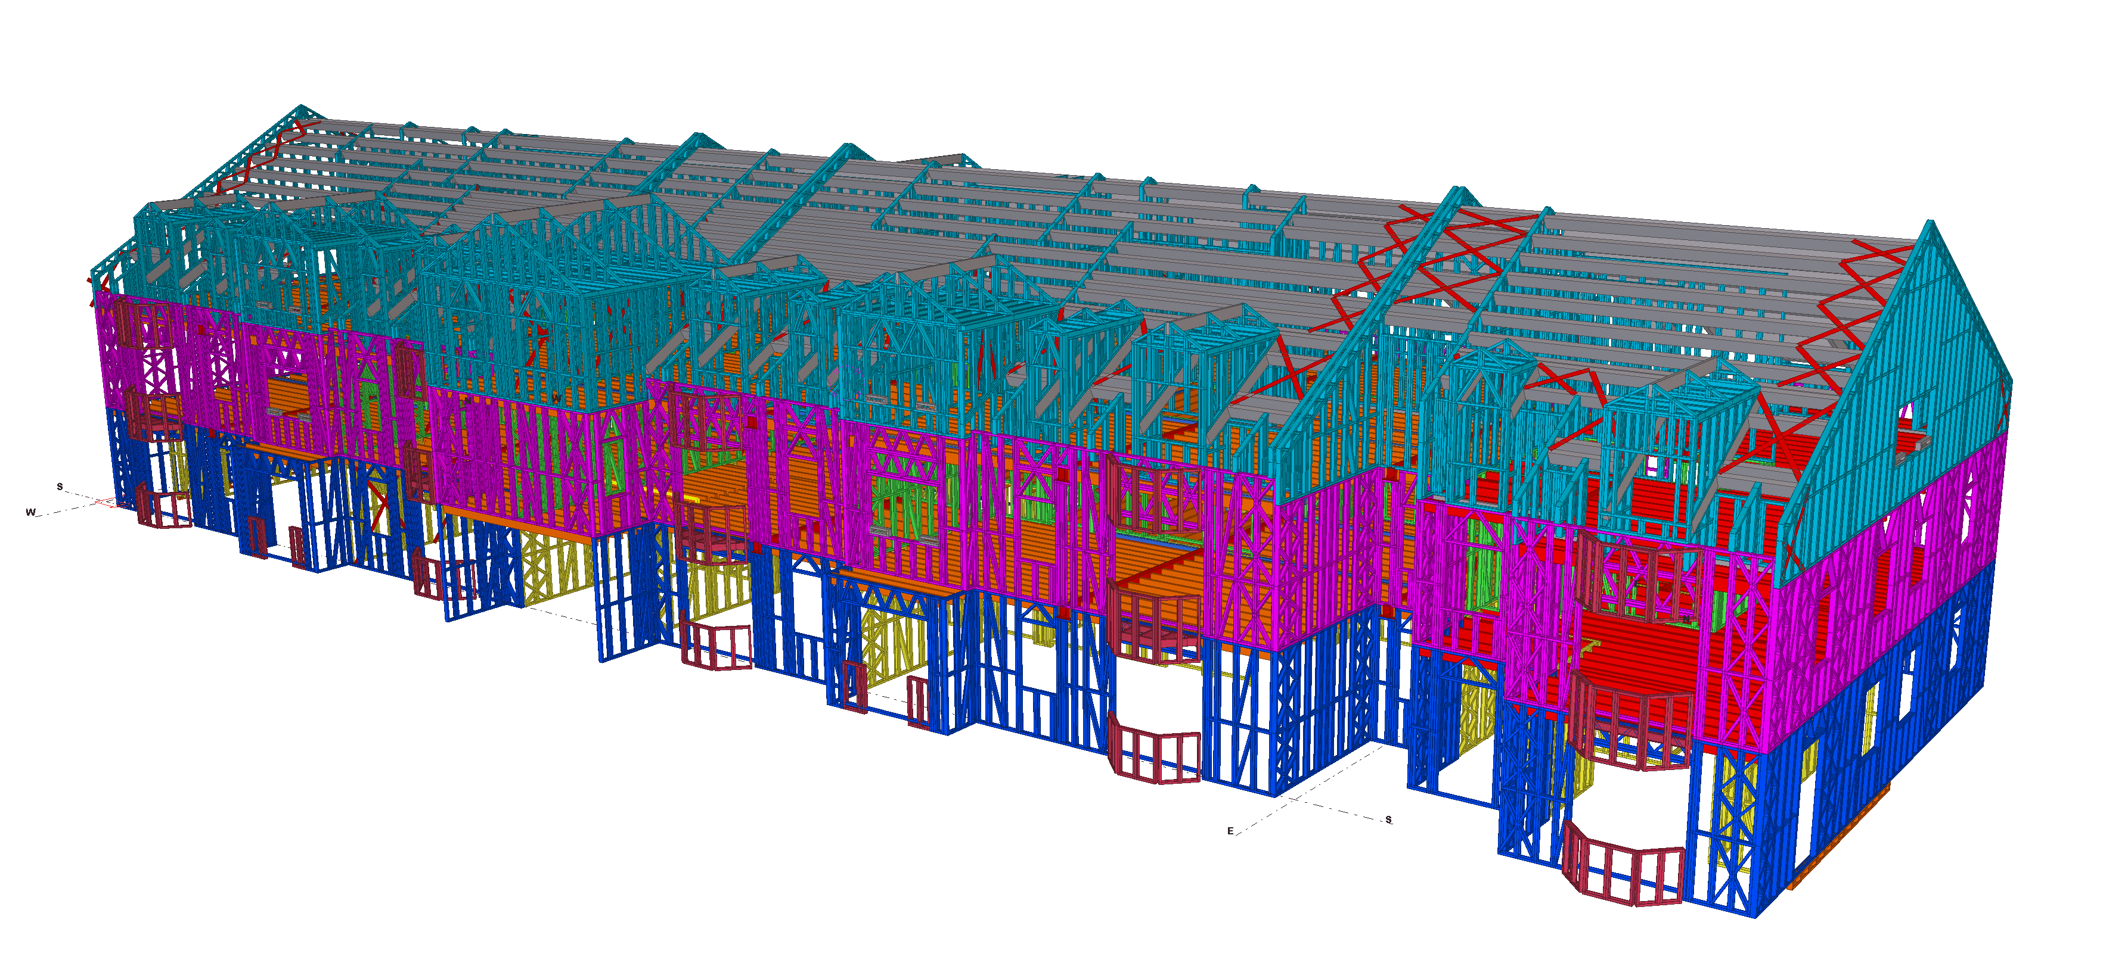
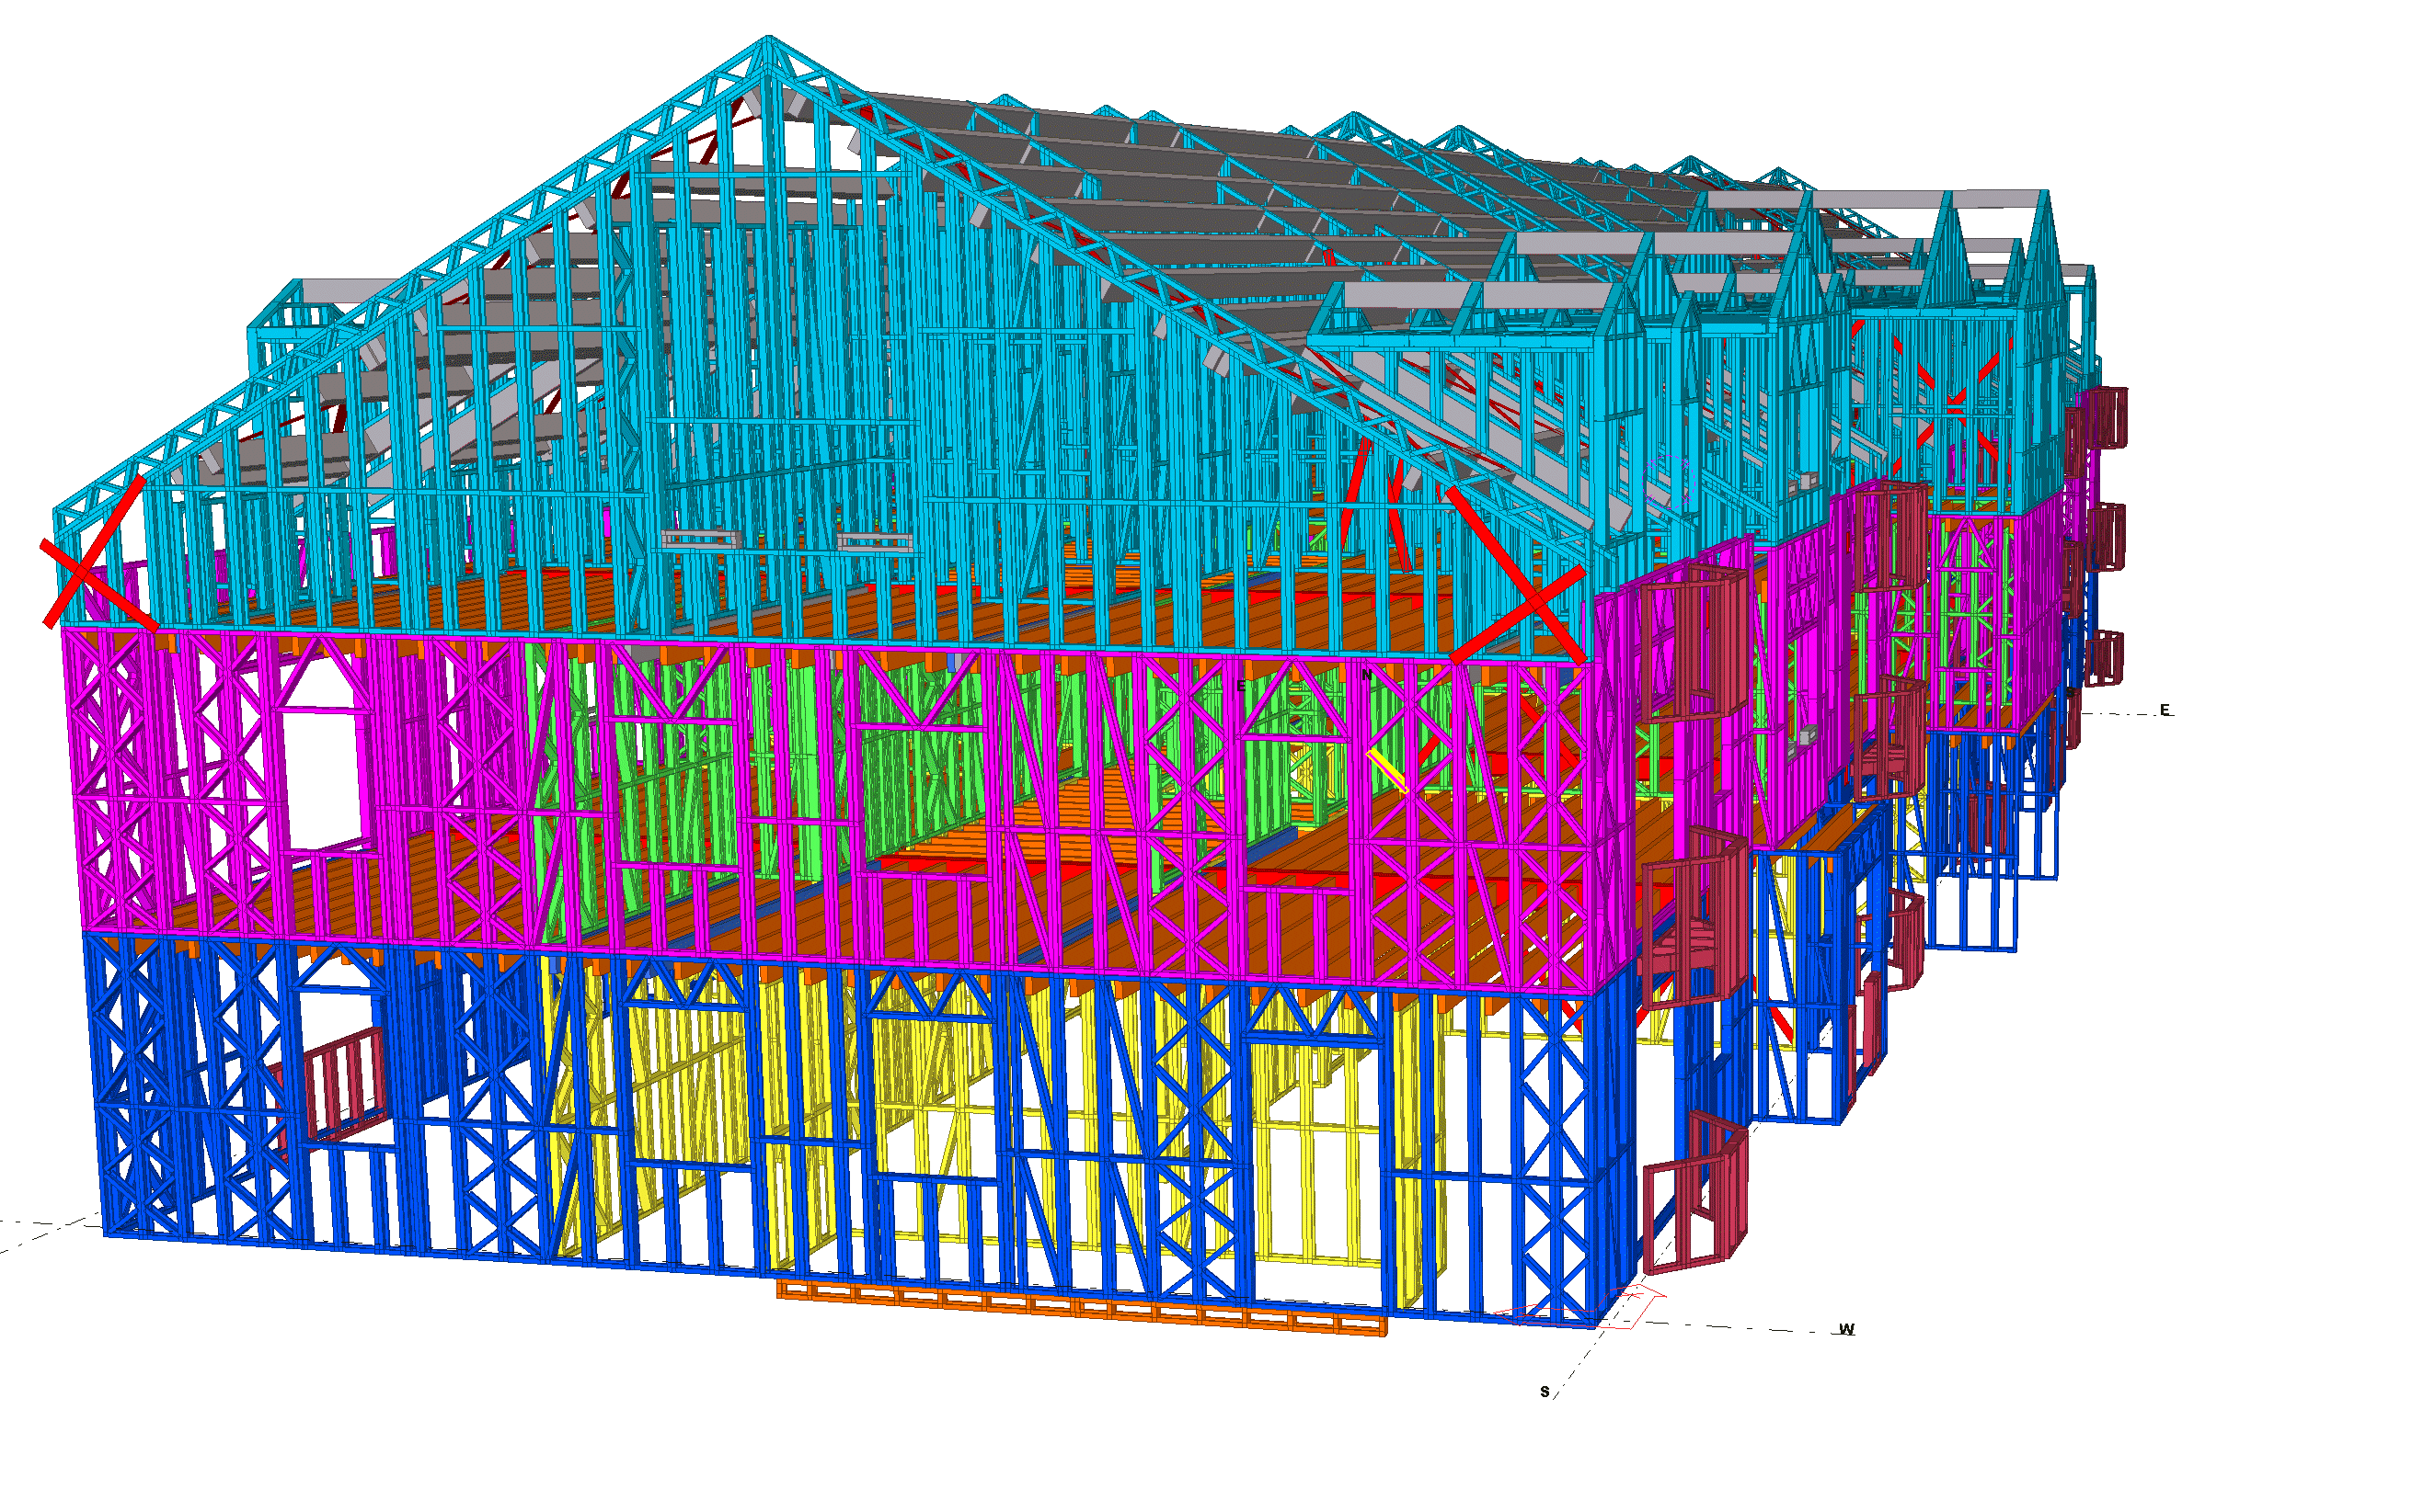
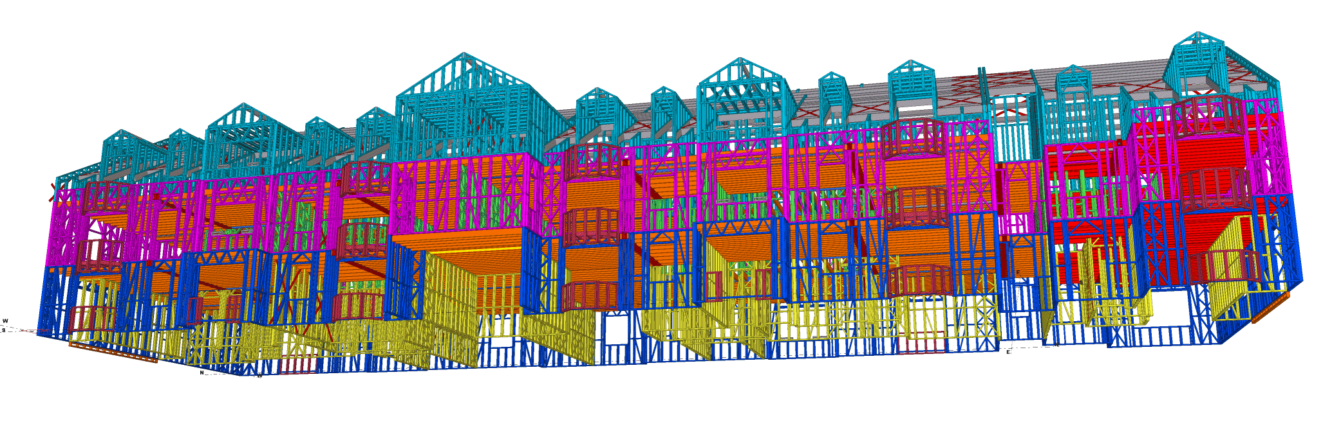
Tekla Structures for Light Metal Frame
Mick Hodgson
2016

Slide 2
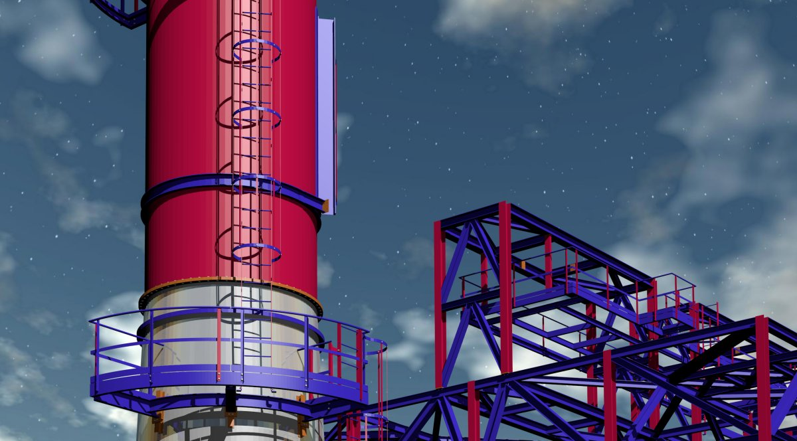

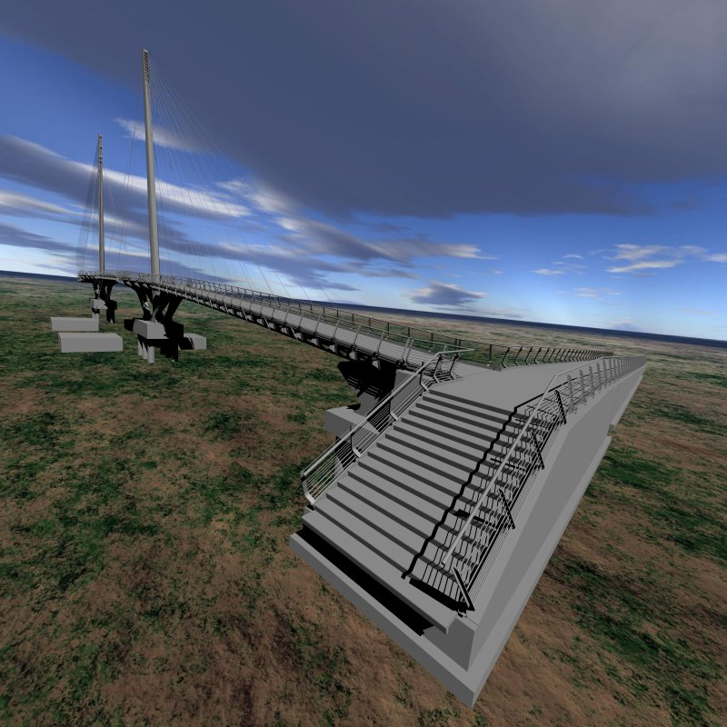
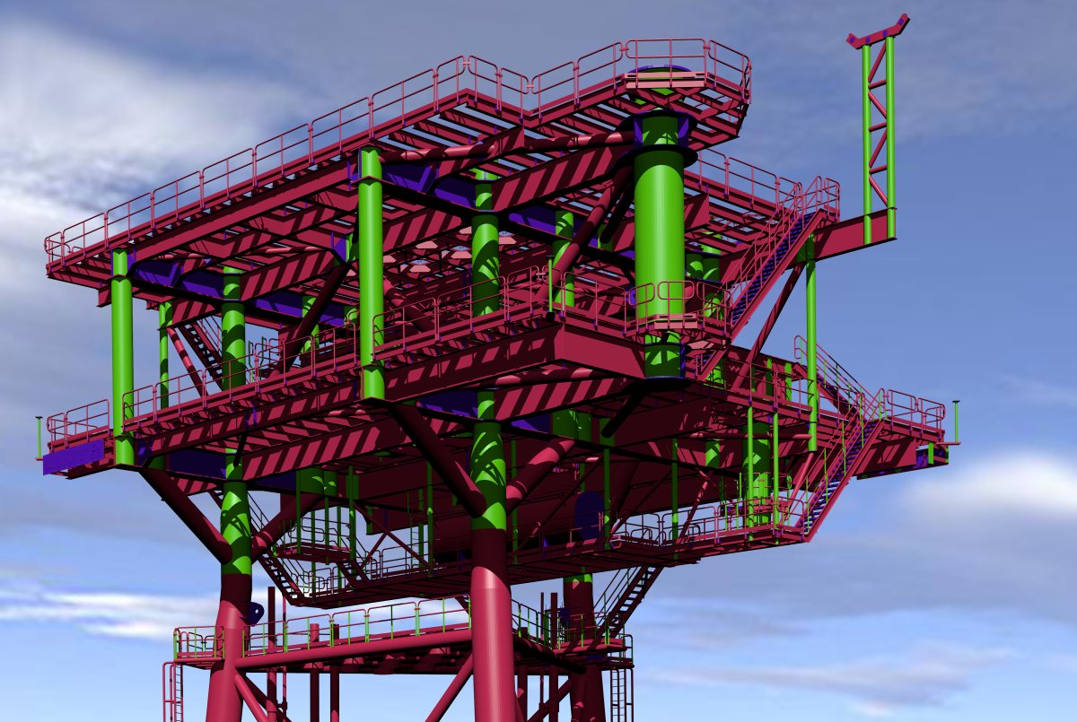


Slide 3
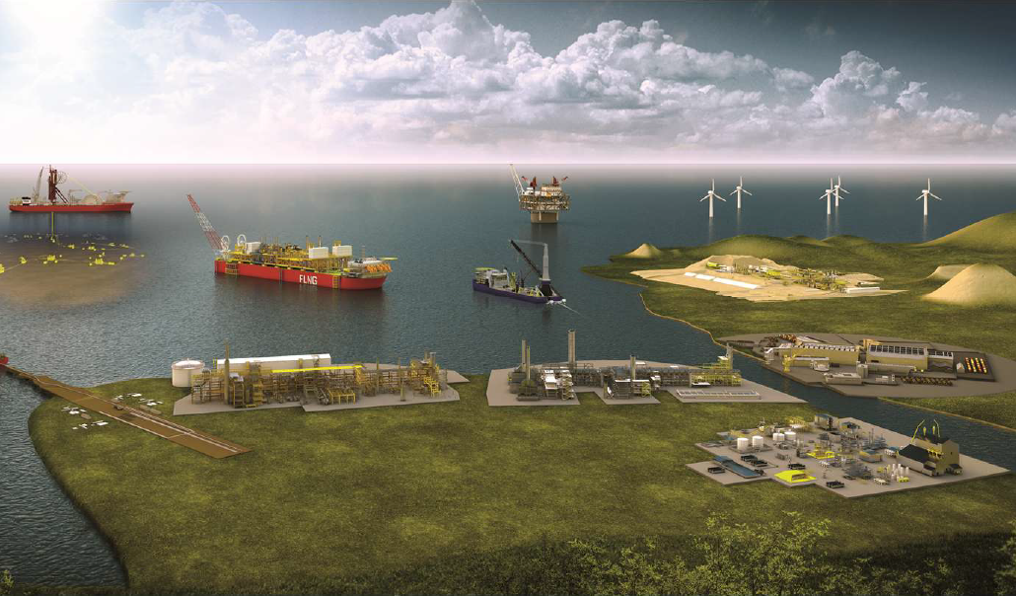
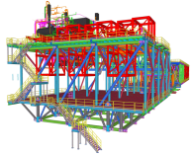
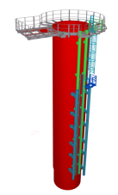
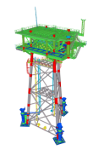
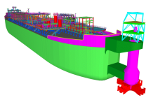


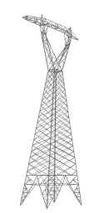
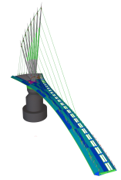
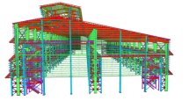

Slide 4
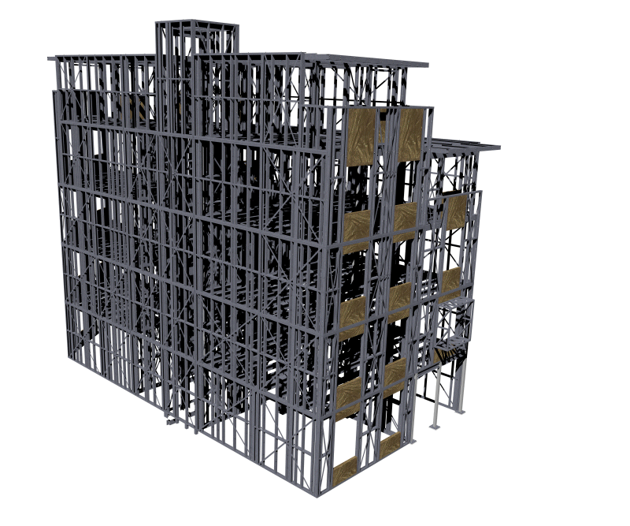
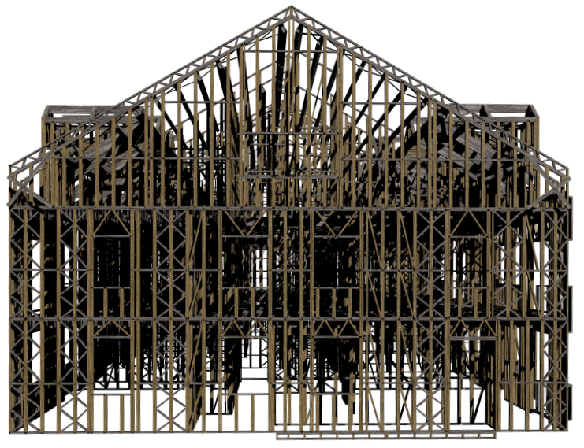
Tekla for structures
Model and detail structures
Ideal for engineers, detailers and fabricators involved in the design, fabrication and management of projects
Collaborate and share design and detailing data, material requirements and project status through the model from design to erection phase

Slide 5
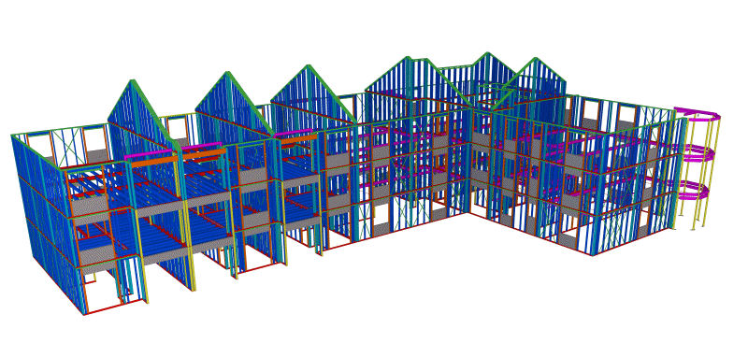
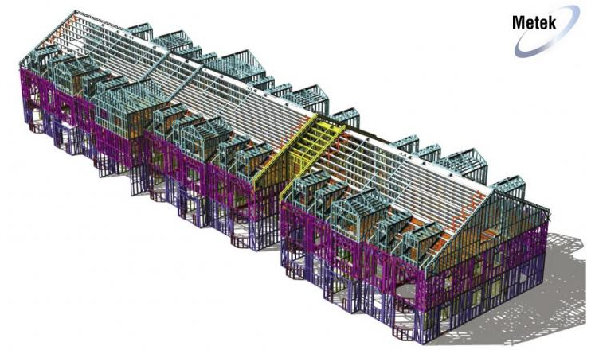
Tekla Structures
Tekla Structures software can handle large and complex projects
Modelling tools cover all kinds of standard profiles and materials including tubular and elliptical sections all the way individual welds and bolts
Tekla Structures can easily integrate to all industry standard packages, such as Smart Plant 3D ,Staad Pro, Questware, PDS, PDMS, providing error-free design and detailing

Slide 6
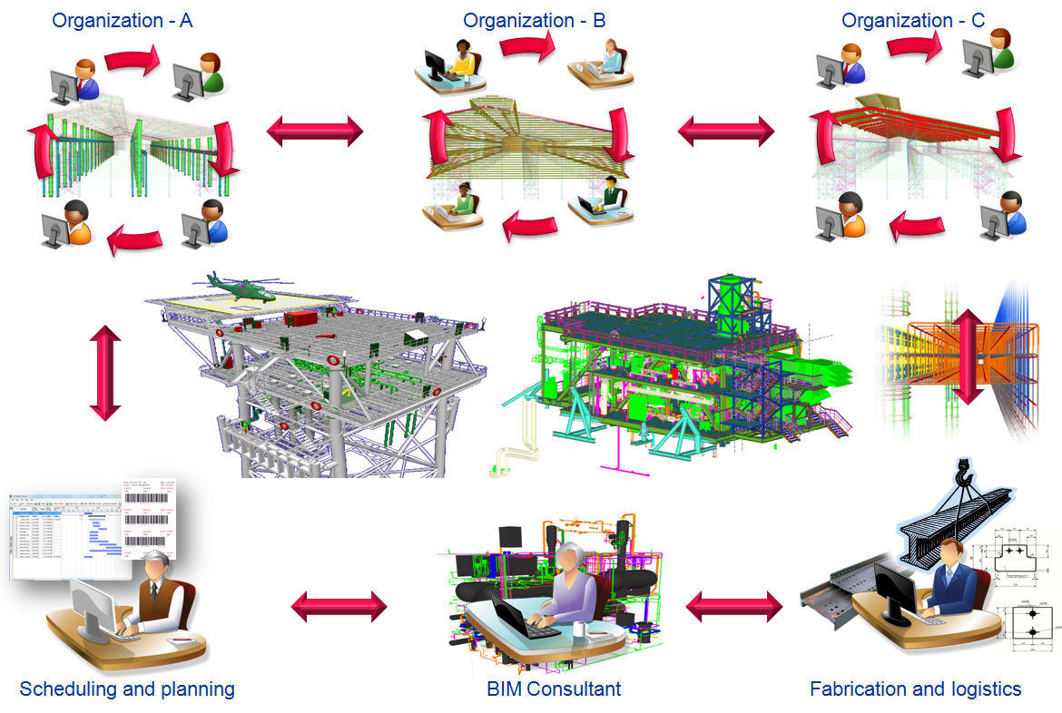
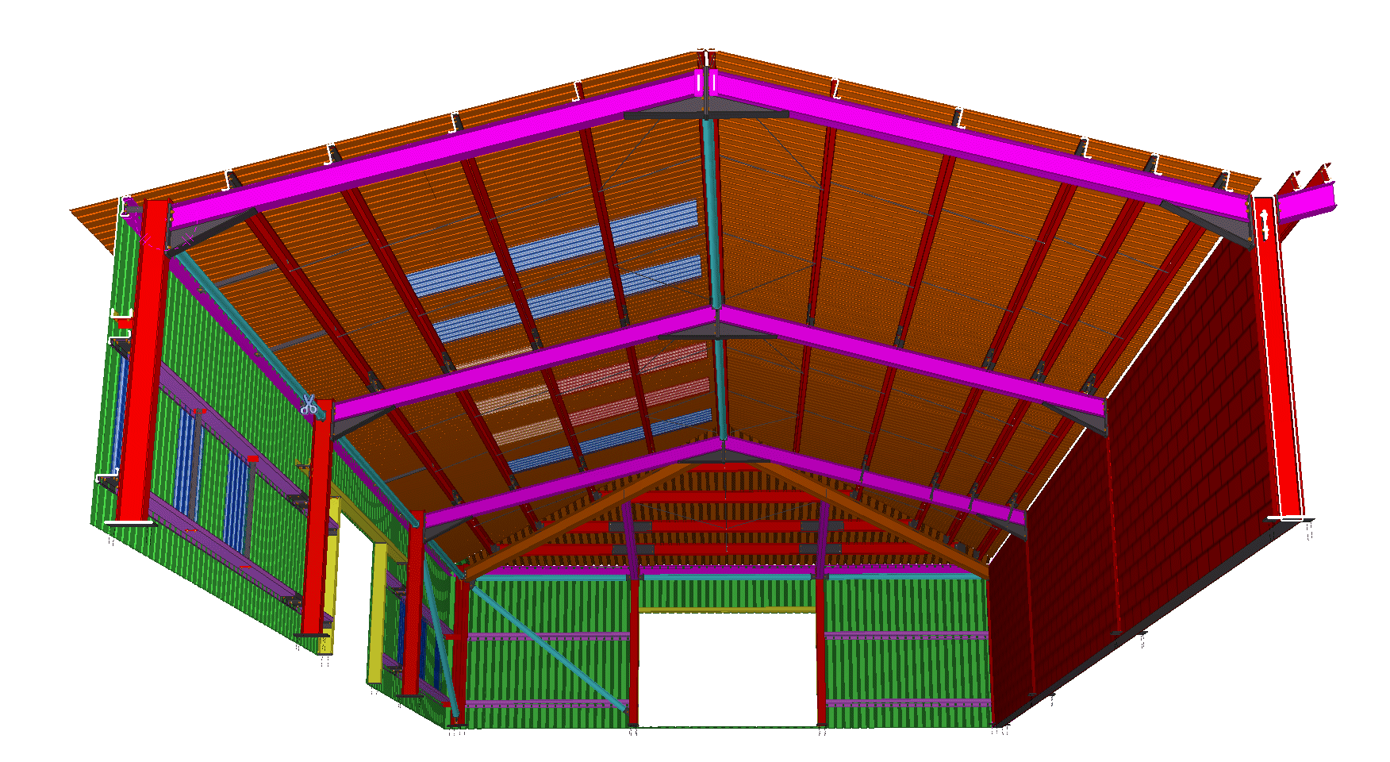
Tekla Structures
Work simultaneously
Quality control assured
Model the whole project

Slide 7


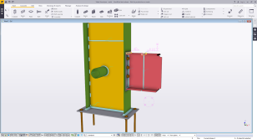
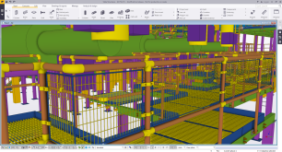
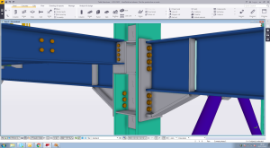

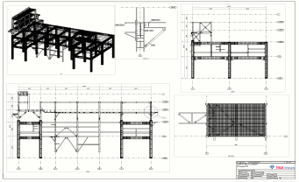
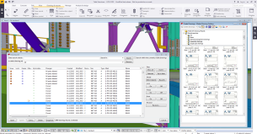
Multi user and Model Sharing
Drawings can be edited while the model is still being completed.
If the same drawing is worked on at the same time a conflict message appears
Modeler can still make and view (and edit) drawings while the Drafter edits other drawings
Workflow – Multi-User Scenario
The Cloud

Slide 8
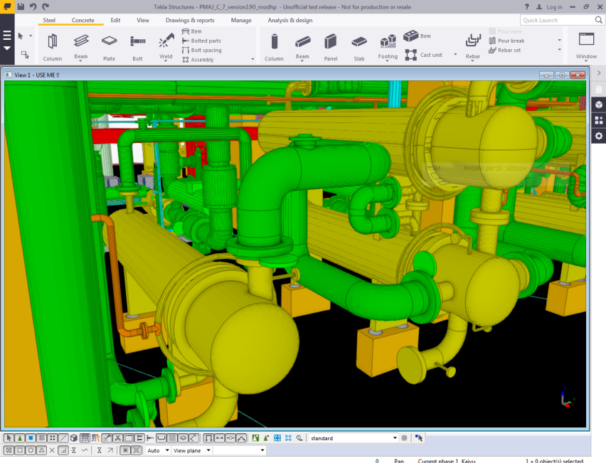
IMPORT
STANDARDS
DWG/DXF
3D DXF
DSTV
SDNF, IFC
CIMsteel (CIS/2)
PLANT MODELLING SYSTEMS
PDMS, E3D, PDS, SMART PLANT
ANALYSIS AND DESIGN SYSTEMS
STAAD PRO, ROBOT, SACS SAP2000
MONORAIL, HLI, CALMA
PLANTVIEW, MICASPLUS, EUREKA LPM
MIS / PLM SYSTEMS
FABTROL STRUMIS STEEL PROJECTS
Supports all Industry standard formats
IFC, CIS/2, DSTV, SDNF, DGN, DXF, DWG, IGES, and STEP
EXPORT
STANDARDS
DWG/DXF
3D DXF
DSTV
SDNF IFC
CIMsteel (CIS/2)
PLANT MODELLING SYSTEMS
PDMS, E3D, PDS, SMART PLANT
ANALYSIS AND DESIGN SYSTEMS
STAAD PRO, ROBOT, SACS SAP2000
MONORAIL, HLI, CALMA
PLANTVIEW, MICASPLUS, EUREKA LPM
MIS / PLM SYSTEMS
FABTROL STRUMIS STEEL PROJECTS

Slide 9
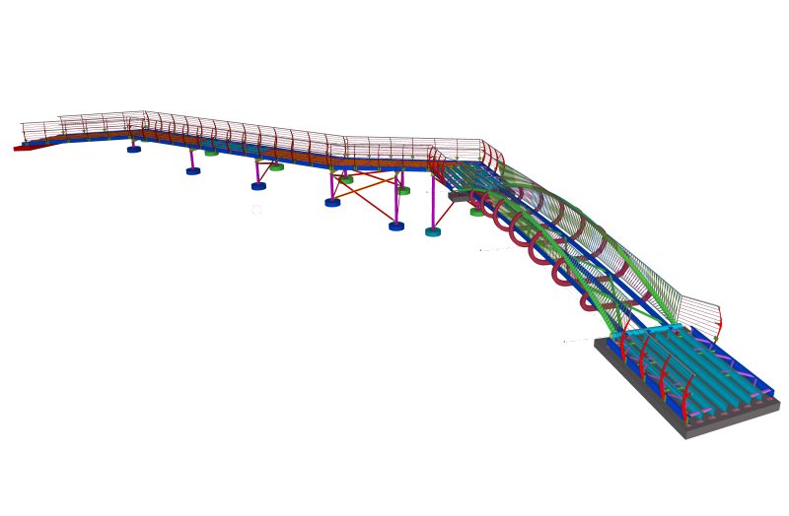
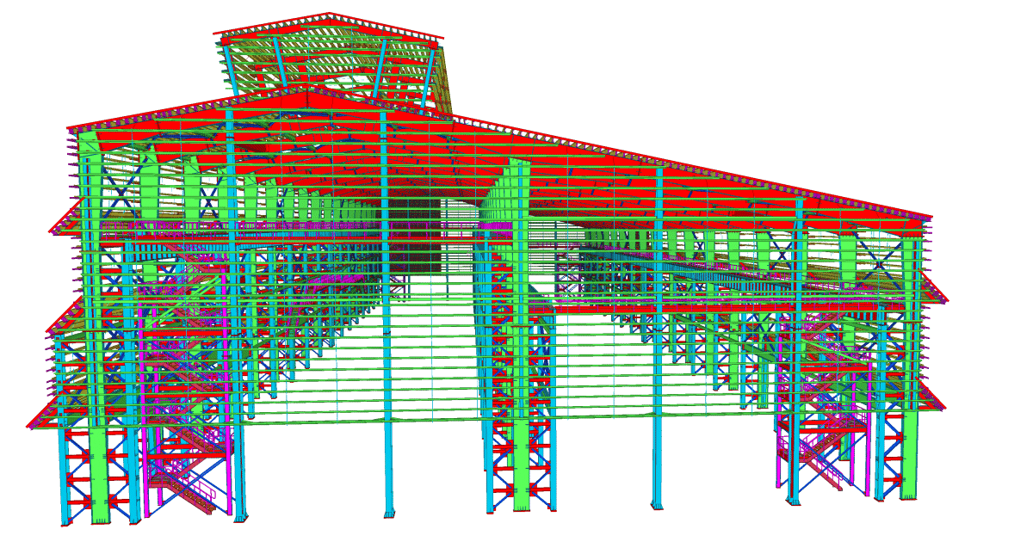
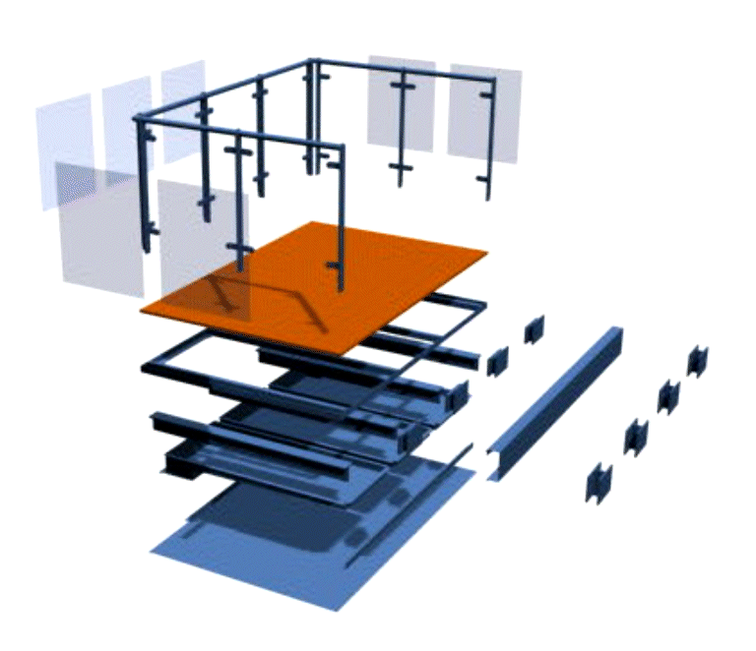
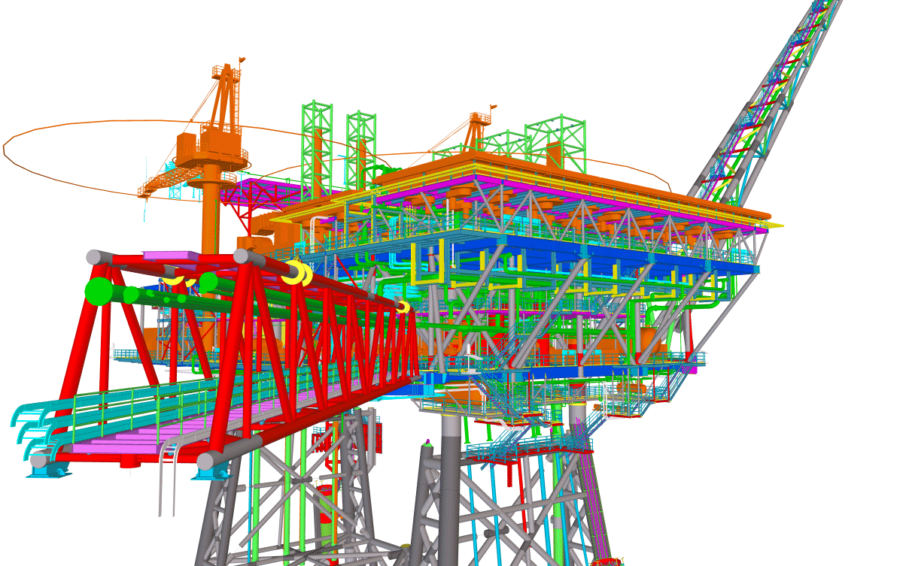
Tekla Structures
Bridge
Structural
Offshore
Misc

Slide 10
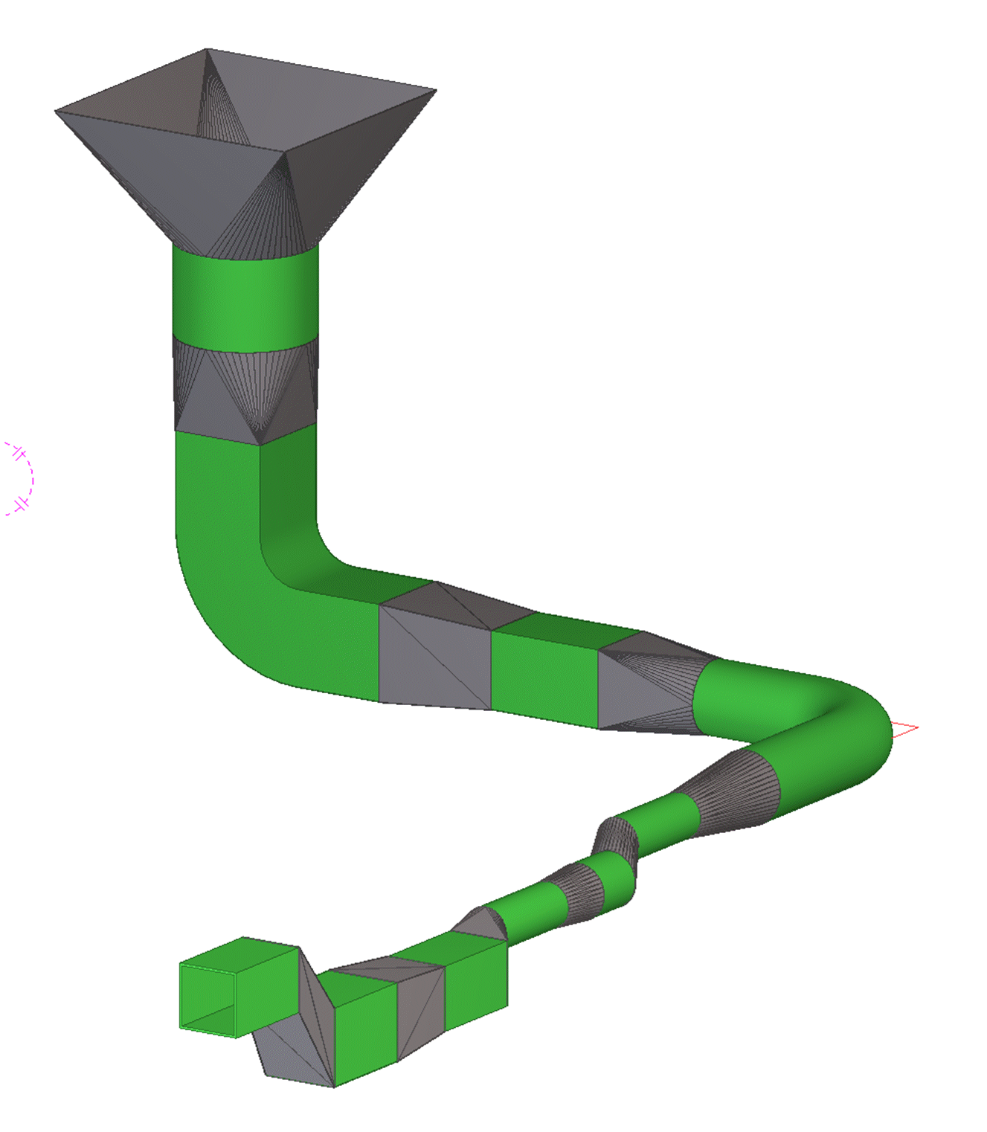
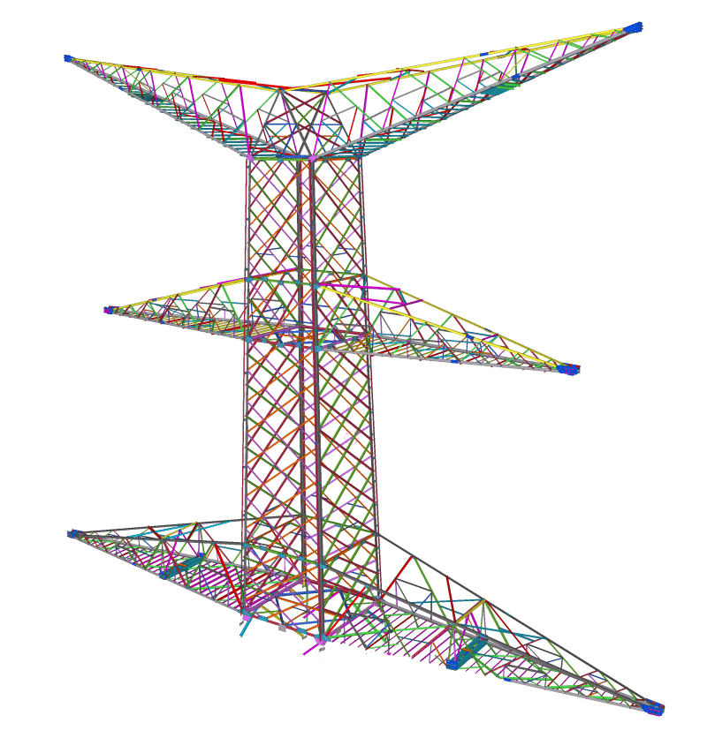
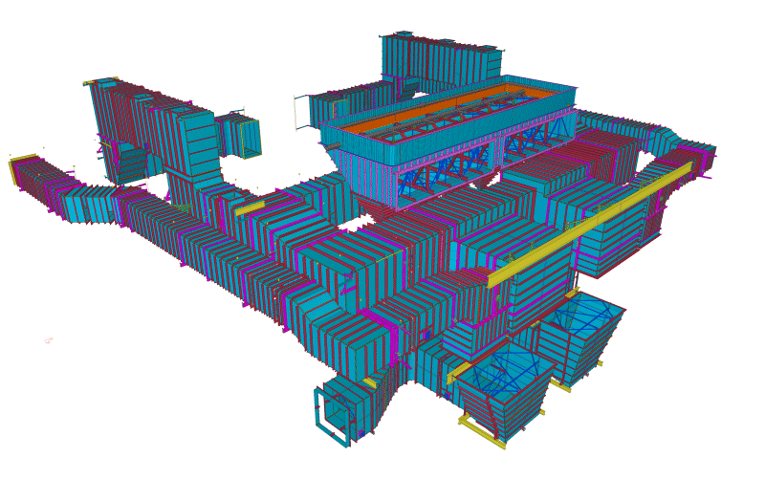
Tekla Structures
Metal Frame
Plate Work
Pylons

Slide 11
Tekla for Metal Frame

Slide 12
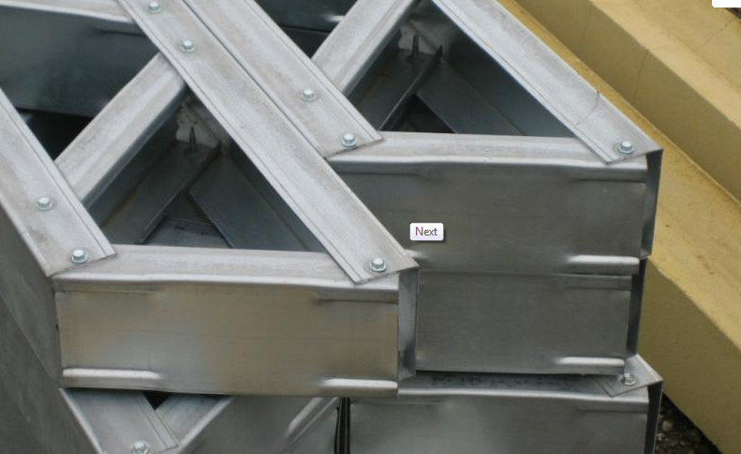
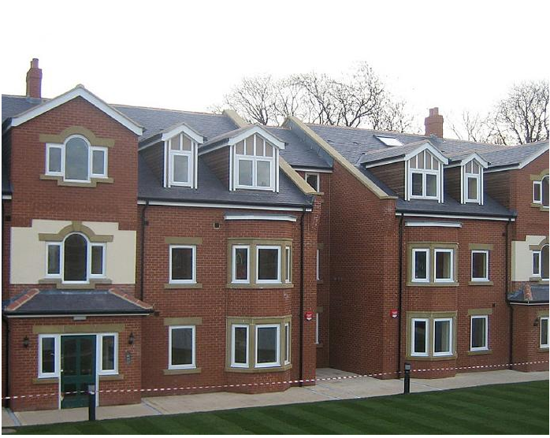
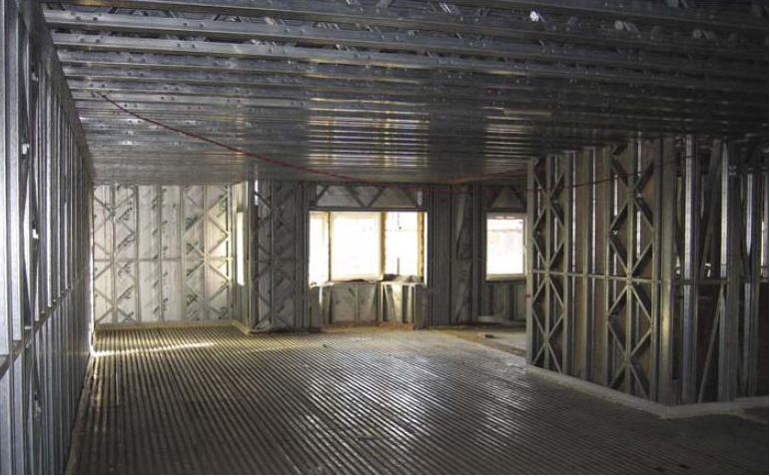
Light Steel Framing

Slide 13
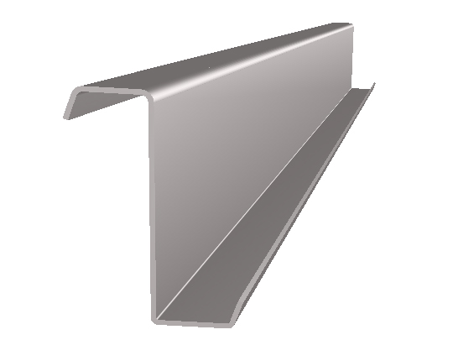
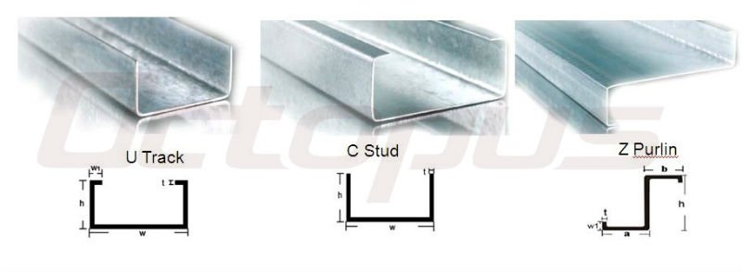
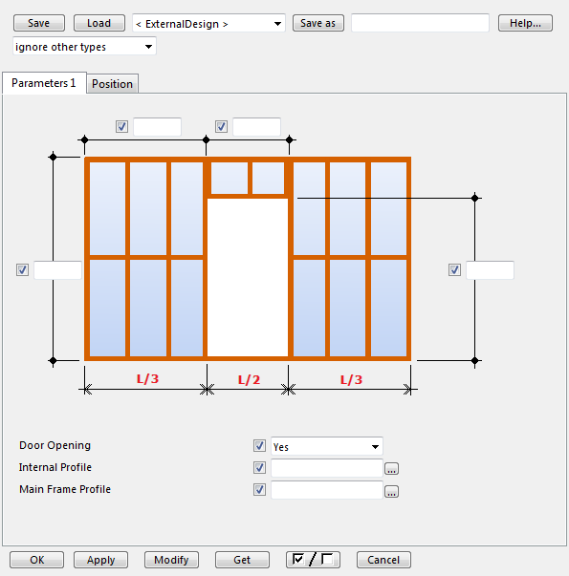
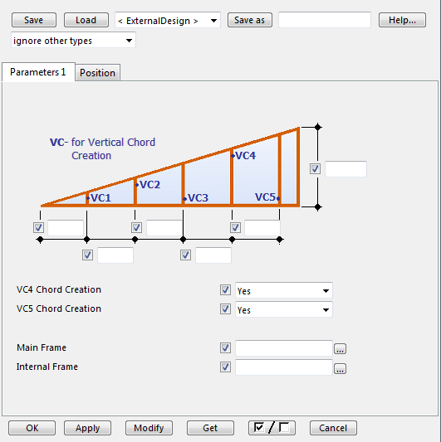
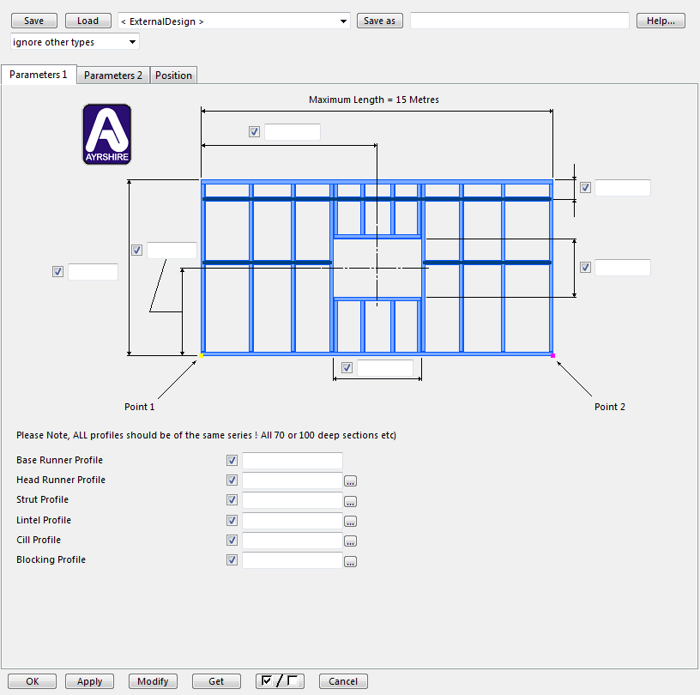
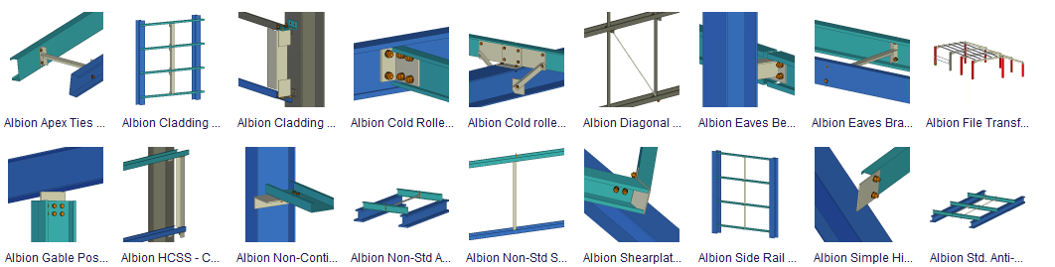
Light Steel Framing

Slide 14
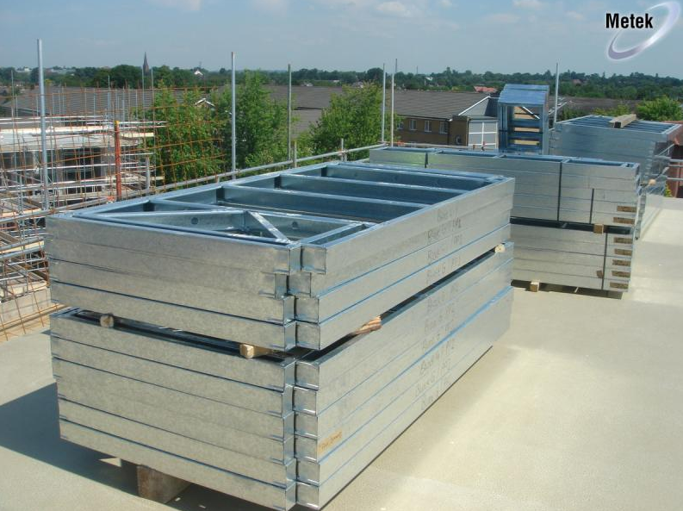
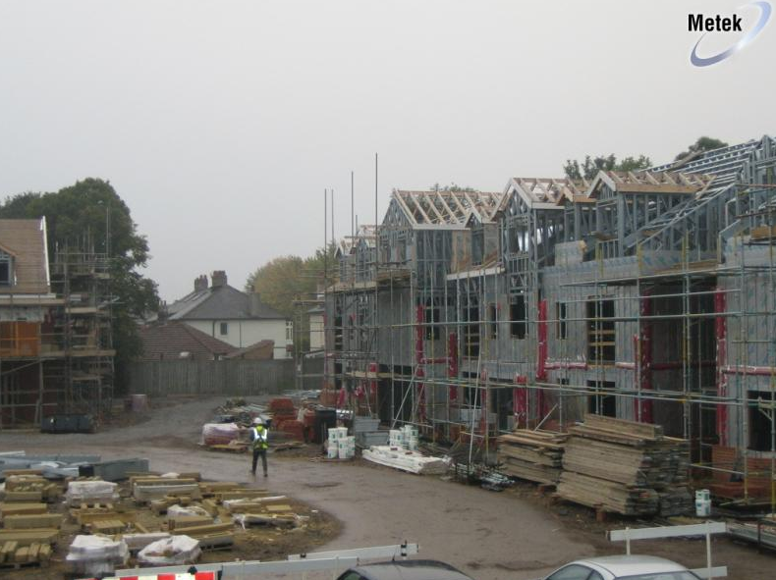
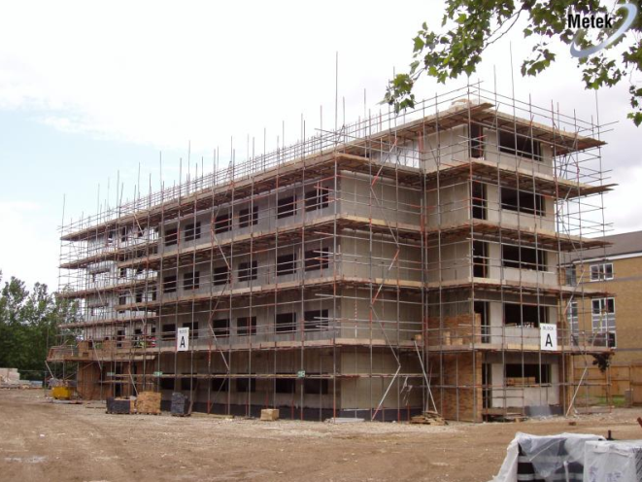
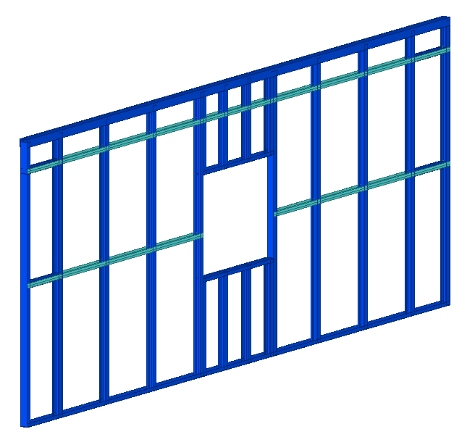
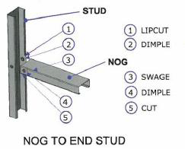
Light Steel Framing

Slide 15
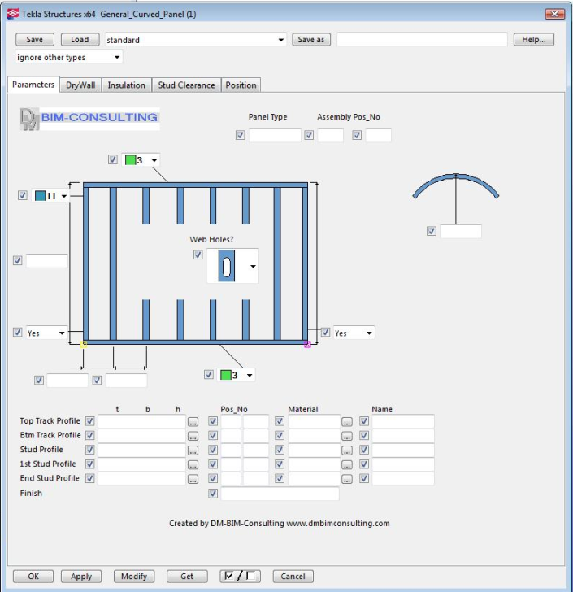
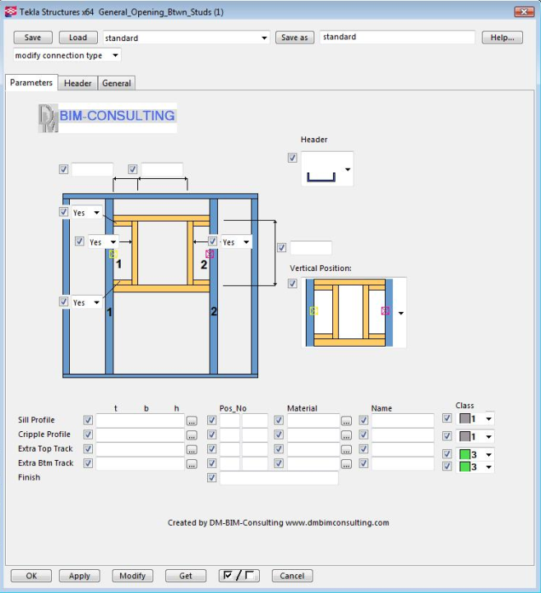
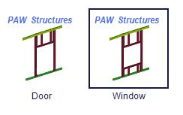


Light Steel Framing custom components

Slide 16


Metal Framing
A new set of tools for an easier way to model light metal frame structures
  Non-load frames
  Panels and holes
  Ceiling
Main Panel
  Easily create walls
  Define studs, bracing, insulation and boarding
Panel Opening
  Easily create windows and
  doors
  Define jambs and headers

Slide 17




Metal Framing

Slide 18




Metal Framing
Ceiling, Frame, Drywall or acoustic

Slide 19



Light Steel Framing

Slide 20




Light Steel Framing

Slide 21






Light Steel Framing cladding
Notes:
Quality

Slide 22




Tekla Structures Engineering drawings

Slide 23








Tekla Structures Fabrication part drawings

Slide 24






Tekla Structures Fabrication assembly drawings

Slide 25




Material Listings
Notes:
Quality

Slide 26



Tekla Structures – Link to Howick CNC machine

Slide 27




Tekla Structures – Link to Samesor CNC machine

Slide 28
We have now done the link to the first Samesor Prefan production line and everything is installed and in use at our client in Turkey already about one month ago. The second line will be delivered with our Tekla components in about one month and after that we have at least 3 more new line this year and upon that we will also do updates for existing clients with existing Prefab lines. Finally we are getting something back after a long period of development. I could say that the components are finalized but they will never be finished while more or less every production line is unique and we will continue to develop.
The main components we have worked on are all the connections and the transfer from TS to Samesor Prefab lines. We have done some and will add more components (for example for wall-elements, roof-trusser, floor-element, portal-structures and more) by time, but these type of components are often customized for specific clients. This simple video should give you some idea:

Slide 29
Thank You
More about Tekla solutions,
references and contacts at www.tekla.com
Mick Hodgson

